Slide 1
Web Programming
Lecture 9
jQuery
Mahhek Tahir
Notes:
.

Slide 2
Introduction to JQuery
What is jQuery?
A fast, small, and feature-rich JavaScript library.
Simplifies HTML document traversal, event handling, and animation.
Ensures cross-browser compatibility.
Why use jQuery?
Concise and easy-to-use syntax.
Reduces the need for complex JavaScript code.
Widely supported and used in web development.

Slide 3
Adding JQuery
Ways to include jQuery:
Download from jQuery.com and include locally.
Use a CDN (e.g., Google or jQuery CDN): <script src="https://code.jquery.com/jquery-3.6.0.min.js"></script>
Placing the script in your HTML file:
Inside the <head> or before closing <body>.
Recommended: Place it before </body> for better performance.

Slide 4
Basic Syntax
Structure: $(document).ready(function() {
// jQuery code here
});
$ is the jQuery selector.
$(document).ready() ensures the DOM is fully loaded before executing scripts.

Slide 5
JQuery Selector
Select elements like CSS selectors:
$("p").hide(); // Hides all `<p>` elements
$("#myId").show(); // Shows the element with ID 'myId'
$(".myClass").fadeOut(); // Fades out elements with class 'myClass'
Common selectors:
$("*")
$(this)
$("ul li")
$("div:first")

Slide 6
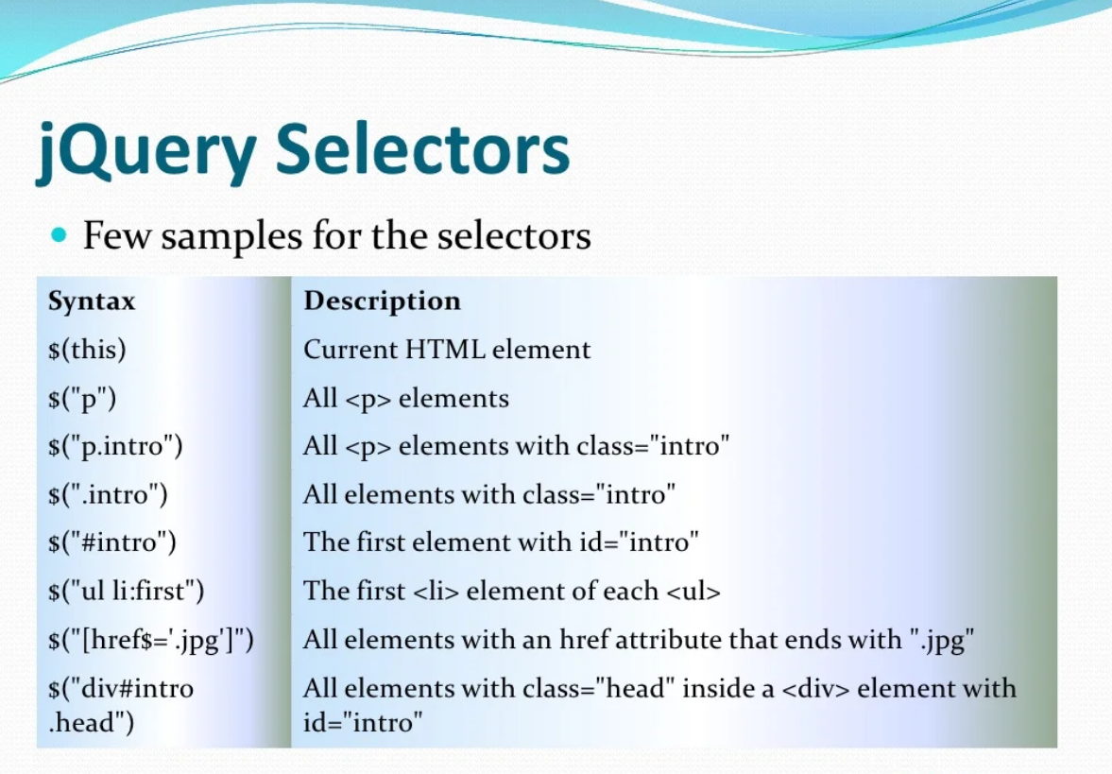

Slide 7
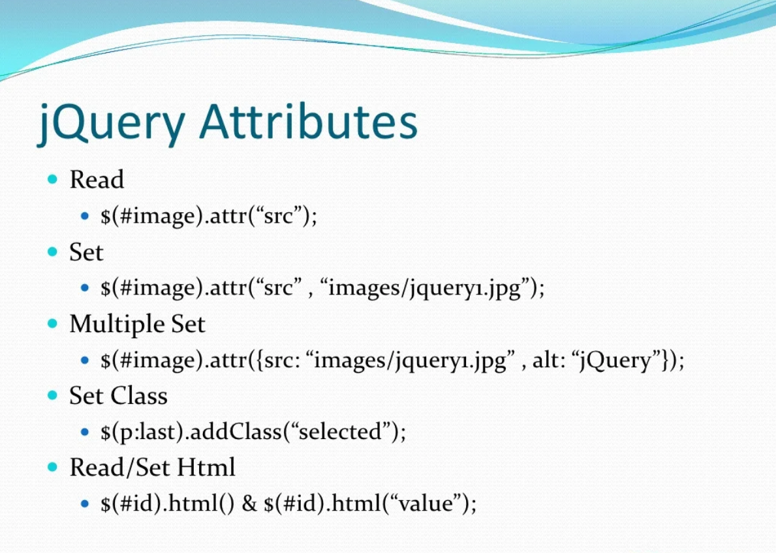

Slide 8
Event handling in JQuery
jQuery makes event handling simple:
$("#btn").click(function() {
alert("Button clicked!");
});
Common events:
click(), mouseover(), mouseleave(), keydown(), submit()

Slide 9
JQuery Effects & Animations
Hide/Show Elements:
$("#box").hide();
$("#box").show();
$("#box").toggle();
Fading Effects:
("#box").fadeIn();
$("#box").fadeOut();
Sliding Effects:
$("#box").slideUp();
$("#box").slideDown();

Slide 10
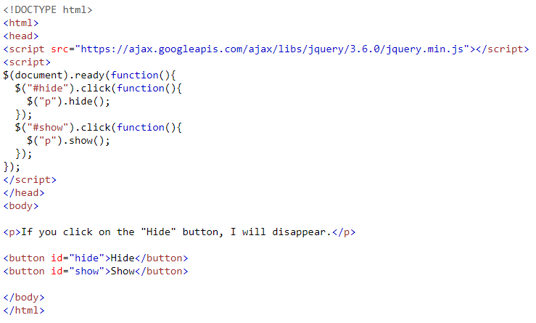
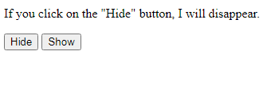
Hide/Show Example

Slide 11
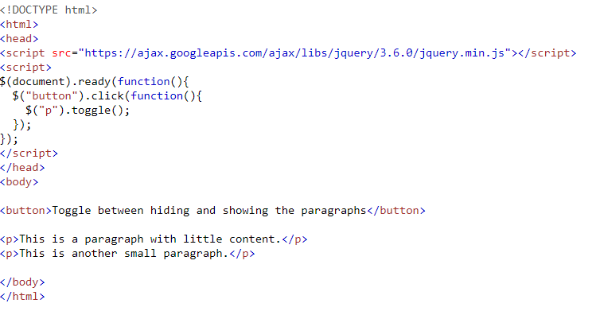
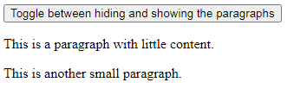
Toggle Example

Slide 12
jQuery Fading Effects
With jQuery you can fade elements in and out of visibility.
Click to fade in/out panel
Examples:
jQuery fadeIn() Demonstrates the jQuery fadeIn() method.
jQuery fadeOut() Demonstrates the jQuery fadeOut() method.
jQuery fadeToggle() Demonstrates the jQuery fadeToggle() method.
jQuery fadeTo() Demonstrates the jQuery fadeTo() method.

Slide 13
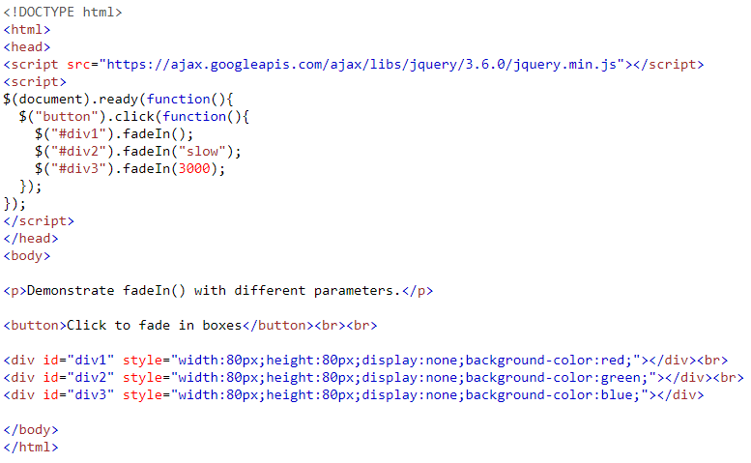
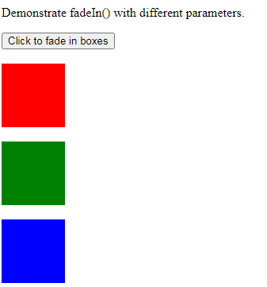
Fading Example

Slide 14
jQuery Effects - Sliding
Examples
slideDown() Demonstrates the jQuery slideDown() method.
slideUp() Demonstrates the jQuery slideUp() method.
slideToggle() Demonstrates the jQuery slideToggle() method.

Slide 15
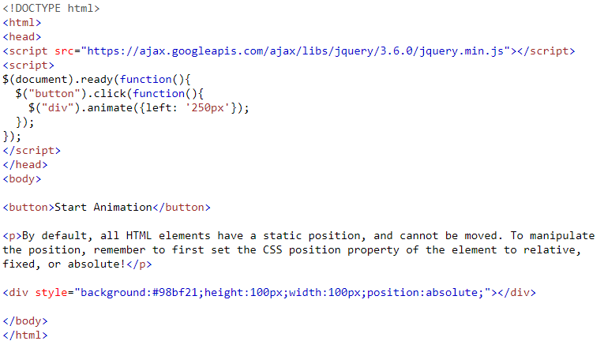
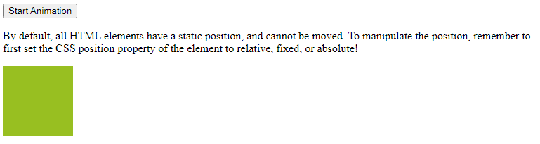
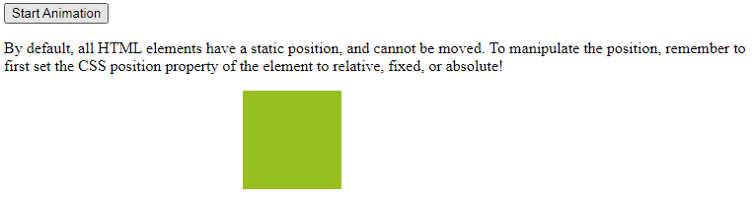
Animate Example

Slide 16
Manipulating HTML and CSS
Change content:
$("#text").text("New Content");
$("#text").html("<b>Bold Content</b>");
Change CSS:
$("#box").css("background-color", "blue");

Slide 17
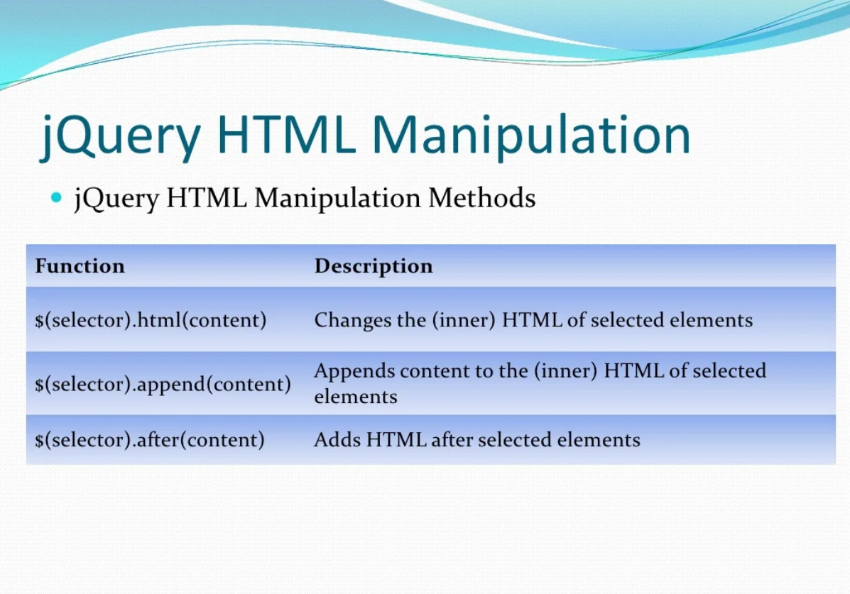

Slide 18
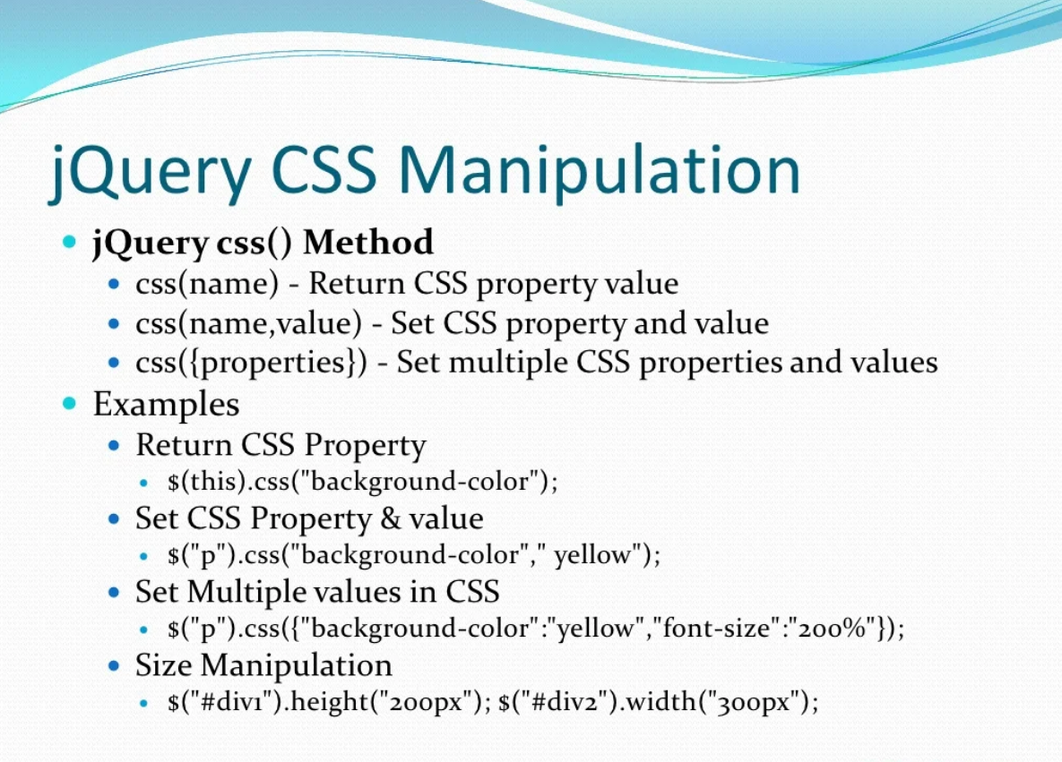

Slide 19
TASKS
Create a counter where:
Clicking the "Increase" button increases the count.
Clicking the "Decrease" button decreases the count.
Clicking the "Reset" button resets the count to zero.

Slide 20
Conclusion and Resources
Why use jQuery in modern development?
Legacy browser support.
Still useful despite modern JavaScript frameworks.
Learning resources:
Official jQuery website: https://jquery.com/
Online tutorials: W3Schools, MDN, jQuery Documentation.
Practice by building small projects!

